Slide 1
Data Modeling And Architecture
Presented by Somaiya Jannat

Slide 2
What is Data Modeling?
It is a technique
Use to create a database from the scratch
In other words, It is a process of transforming data into Information

Slide 3
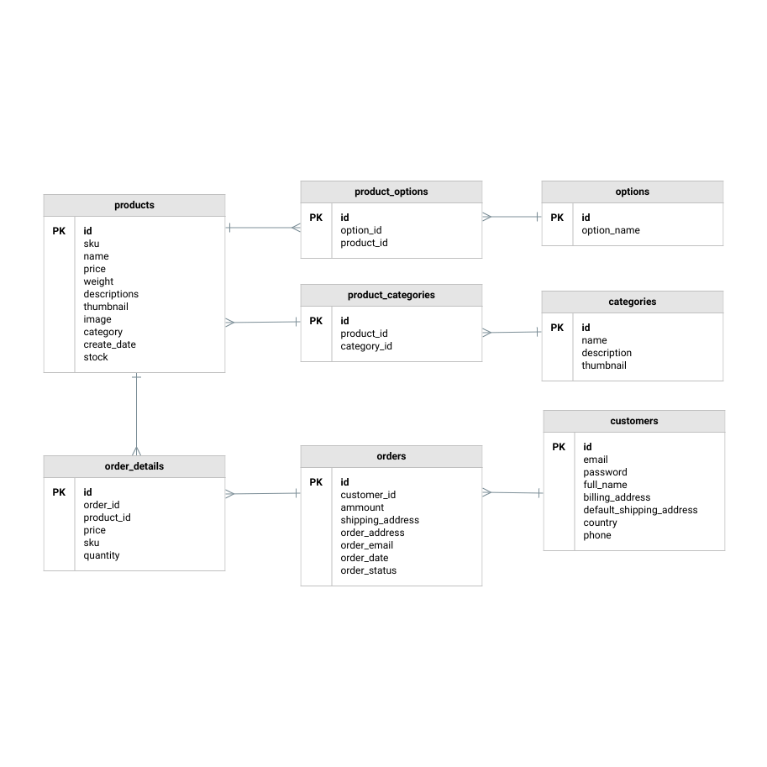
Example of Data Modeling
For example, a data model for an eCommerce business will contain vendors, products, customers, and sales.

Slide 4
Why Data modeling is Used?
A comprehensive and optimized data model helps to create
A simplified, logical database
Eliminates redundancy
Reduces storage requirements
Enables efficient retrieval.

Slide 5
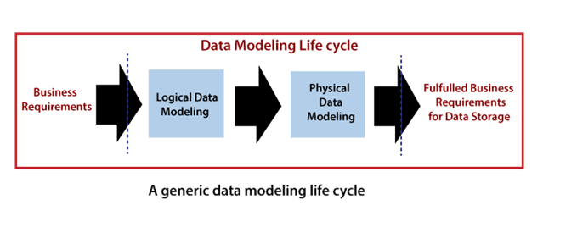
Data Modeling Life Cycle
The objective of the data modeling life cycle is primarily the creation of a storage area for business information. That area comes from the logical and physical data modeling stages, as shown in Figure:

Slide 6
Goals of Data Modeling
Straight forward process of transforming the business requirements to fulfill the goals for
Storing
Maintaining
Accessing the data within IT System

Slide 7
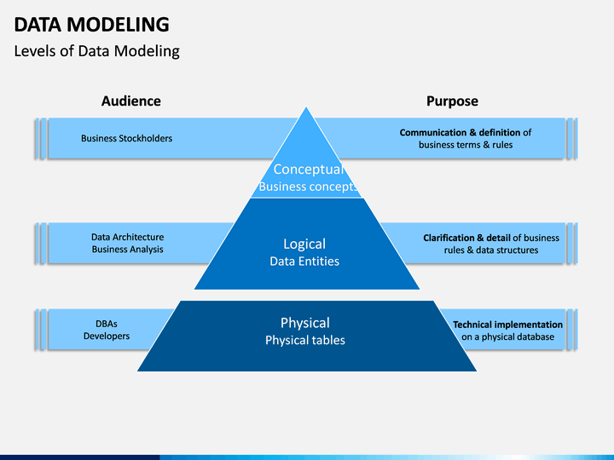
Types Of Data modeling
There are 3 different types of Data Model.
Conceptual Data Model
Logical Data Model
Physical Data Model

Slide 8
Conceptual Model
Definition:
This Model defines what’s the Model Contains.
Defines how the system should be implemented regardless of RDBMS
Organized view of database concept and relationship
Business stakeholders and data architects typically create conceptual data model
Purpose:
Establish Entities, Attributes, Relationship
Detail hardly available on actual database Data Structure

Slide 9
Conceptual Data Model
The 3 basic components of Conceptual Data Model are:
Entity: A real-world thing
Attribute: Characteristics or properties of an entity
Relationship: Dependency or association between two entities

Slide 10
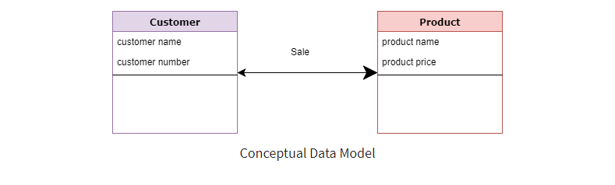
Example of Conceptual Data Model
Customer and Product are two entities.
Customer number and name are attributes of the Customer entity
Product name and price are attributes of product entity
Sale is the relationship between the customer and product

Slide 11
Characteristics of Conceptual data model
Wide Coverage of business concept
Designed and developed for business audience
Developed for user including specification like :
Data storage capacity
DBMS vendor and technology(Vendors: Oracle, IBM, Microsoft and Sybase)

Slide 12
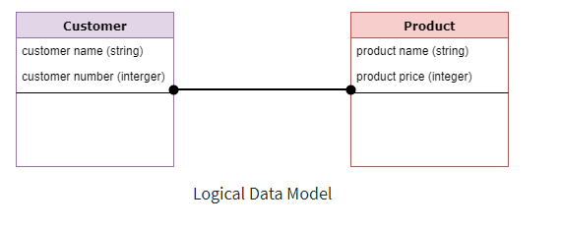
Logical Data Model
Defines HOW the system should be implemented regardless of the DBMS.
Set relationship between them
Adds further information to the conceptual data model
No primary key and foreign key is specified
This model is typically created by Data
Architects and Business Analysts.

Slide 13
Characteristics of Logical Data Model
Describes data needs for a single project but could integrate with other logical data models based on the scope of the project.
Designed and developed independently from the DBMS.
Data attributes will have datatype with exact precisions and length.
Normalization processes to the model is applied typically till 3NF.

Slide 14
Comparing the logical data model with the conceptual data model
Logical Data Model | Conceptual Data Model
Primary keys are present | No Primary key is present
All attributes are specified within an entity. | No attributes are specified
Relationships are specified | Relationships are not specified, Simply stated

Slide 15
Physical Data Model
This data model describes HOW the system will be implemented using a specific DBMS System
Or how the model will be built in the database. It shows
Table structures
Column name, Datatype, Constraints
Relationship between table like Primary key, Foreign key
Created by
DBA
Developers

Slide 16
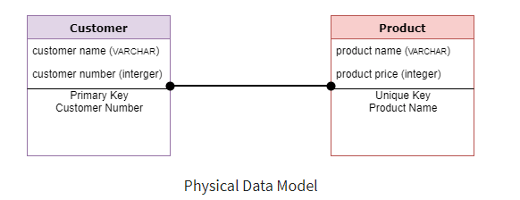
Physical Data Model

Slide 17
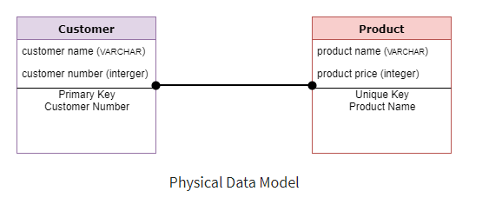
Steps of Physical Data Model
Convert entities into tables.
Convert relationships into foreign keys.
Convert attributes into columns.

Slide 18
Comparing the physical data model with the logical model
Entity names are now table names.
Attributes are now column names.
Data type for each column is specified. Data types can be different depending on the actual database being used.

Slide 19
Advantages of Data Modeling
Higher Quality
Reduce Cost
Accurate Data Representation
Relationship between database objects
Faster Performance
Better Documentation
Fewer Application Error
Fewer Data Errors
Managed Risk
A good start for data mining

Slide 20
What is Data Architecture
Data architecture is the foundation of an effective data strategy.
It is a framework of models, policies, rules and standards
That an organization uses to manage data
Controls how the collected data should be :
Stored
Arranged
Integrated and its flow through the organization.

Slide 21
Data Architecture Principles
Validate All Data at Point of Entry
Eliminating bad data and common data errors
Strive for Consistency :
For example a certain style of button should always do the same thing
Everything Should be Documented:
data visibility and data remain standardized across the organization

Slide 22
Data Architecture Principles
Avoid Data Duplication and Movement
Reduce cost, improve data freshness and optimize data agility.
Users Need Adequate Access to Data
Provide right interface for users
Security and Access Controls Are Essential

